Slide 1
AWS IAM
Identity and Access Management

Slide 2
Basics
A global service, IAM is not bound to an individual region.
Root accounts, never use them they should only be used to create admin user

Slide 3
Users Groups
People within the organization
Users can belong to multiple groups, or no groups at all
Groups contain multiple users, but can not contain other groups.

Slide 4
Permissions
Users or Groups can be assigned JSON documents to limit access to aws resources. Some limitations include limiting to only specific instances of a service, or even the actions that the user can do on a specific service.

Slide 5
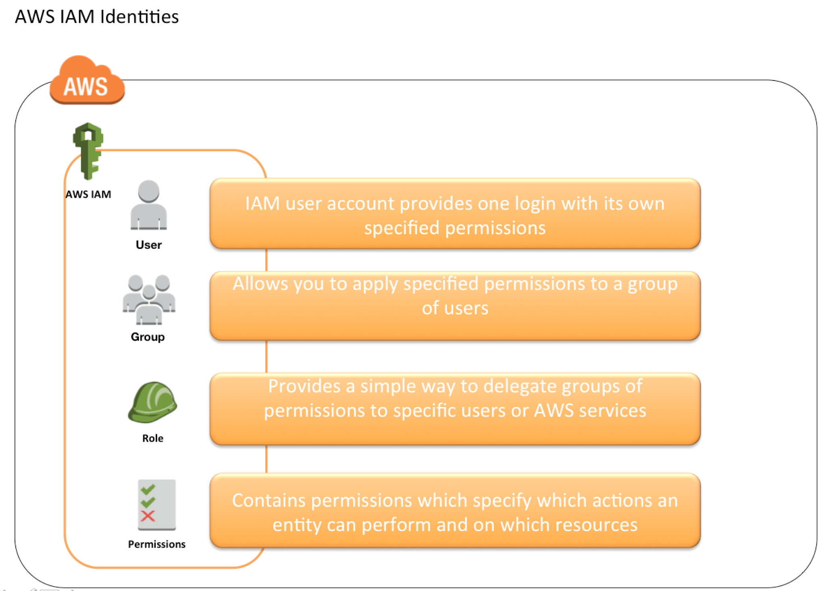

Slide 6
AWS BEST PRACTICE
Least privilege principle, don’t give more permissions then a user needs.

Slide 7
IAM Policies Inheritance
IAM policies assigned to a group will be passed on or inherited by the users within the group.

Slide 8
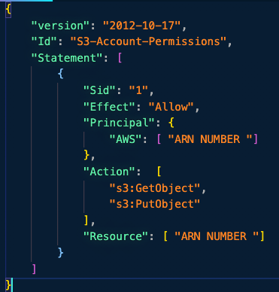
IAM Policies
Consists of:
Version (required)
Id (optional)
Statement (required)
Statements consist of
Sid: Identifier for the statement (optional)
Effect
Principal
Action
Resource
Condition (optional)

Slide 9
Pro Tip: If you need to write a policy go into the IAM console, and create it manually, without actually making it there is a button to show you the JSON for the policy which you can then copy pasta

Slide 10
IAM Roles For Services
Unlike IAM users, IAM roles are designed for AWS services. By assigning permissions you can then allow access for AWS services to use other AWS services.

Slide 11
IAM POLICies Conditions
"Condition" : { "{condition-operator}" : { "{condition-key}": "{condition-value}"}}
Operators:
StringEquals, StringNotEquals, StringLike
“Condition” : { “StringEquals” : { “aws:PrincipalTag/job-category” : “iamuser-admin” }}
“Condition” : { “StringLike” : { “s3:prefix”: [ “”, “home/”, “home/${aws:username}/”] } }
Numeric (NumericEquals, NumericNotEquals, NumericLessThan)
Date (DateEquals, DateNotEquals, DateLessThan )
Boolean (Bool):
“Condition” : { “Bool” : { “aws:SecureTransport”: “true”}}
“Condition” : { “Bool” : {“aws:MultiFactorAuthPresent” : “true”}}
(Not)IPAddress:
“Condition” : { “IpAddress” : { “aws:SourceIP” : “203.0.113.0/24”}}
ArnEquals, ArnLike
Null:
“Condition” : { “Null”: { “aws:TokenIssueTime” : “true” }}

Slide 12
IAM Policies Variables and Tags
Example ${aws: username}
“Resource”: [“arn:aws:s3:::mybucket/${aws:username}/*”]
This will allow a user to have full access over this subsection of and s3 bucket.

Slide 13
Some Specific Examples
AWS Specific
aws:currentTime
aws:TokenIssueTime
Aws:principaltype,
aws:secureTransport
aws:SourceIP
Aws:userid
ec2:SourceInstanceARN
Service Specific
S3:prefix
S3:max-keys
S3:x-amz-acl
SNS:Endpoint
SNS:Protocol
etc
Tag based:
iam:ResourceTag/key-name
aws:PrincipalTag/key-name….

Slide 14
IAM Roles vs Resource Based Policies
When you assume a role (user, application, or service), you give up your original permissions and take the permissions assigned to the role
When using a resource based policy, the principal doesn’t have to give up any permissions
Some examples of services that have resource based policies include
Amazon S3, SNS topics, SQS queues

Slide 15
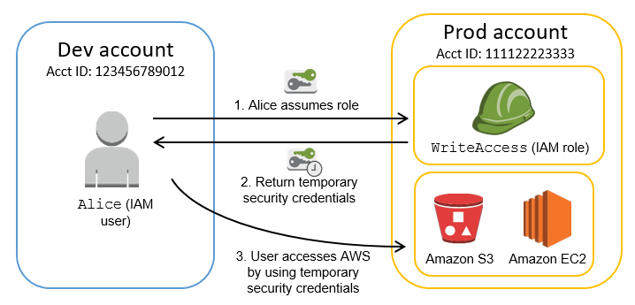
Using STS to Assume Roles
Define a IAM Role within the account or cross account
Define which principals can access this IAM role
Use the AWS STS (Security Token Service ) to retrieve credentials and impersonate the IAM role you have access to (AssumeRoleAPI)
Temporary credentials can be valid for 15 minutes up to 1 hour

Slide 16
Conditions for Assuming ROles
Provide access for other IAM users in one AWS account that you own to another account that you own.
Provide access to IAM users in AWS accounts owned by third parties
Provide access for services offered by AWS to AWS resources
Provide access for externally authenticated users

